Slide 1
LACERATION

Slide 2
LACERATION
Laceration are the tears or splits of skin, mucous membrane, muscle or internal organs produced by application of blunt force to broad area of the body, which crushed or stretched the tissues beyond their elasticity.

Slide 3
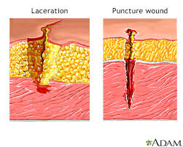
Laceration

Slide 4
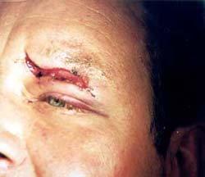
Laceration

Slide 5

Laceration

Slide 6
Blunt impact to any bony area of the body is likely to produce contusion when overlying tissues are forcibly and rapidly compressed against the bone it is known as contused laceration or bruised tear
If margins are abraded, it is called abraded laceration or scraped tear
If blunt force produces extensive bruising and tear of deeper tissues, it is called crushing.

Slide 7
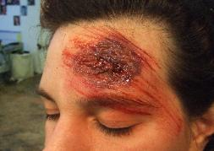
ABRADED TEAR

Slide 8
Types :
1. Split lacerations
2. Stretch lacerations
3. Avulsion(shearing laceration)
4. Tears
5. Cut lacerations

Slide 9
SPLIT LACERATIONS
It occurs by crushing of the skin between
two hard objects

Slide 10
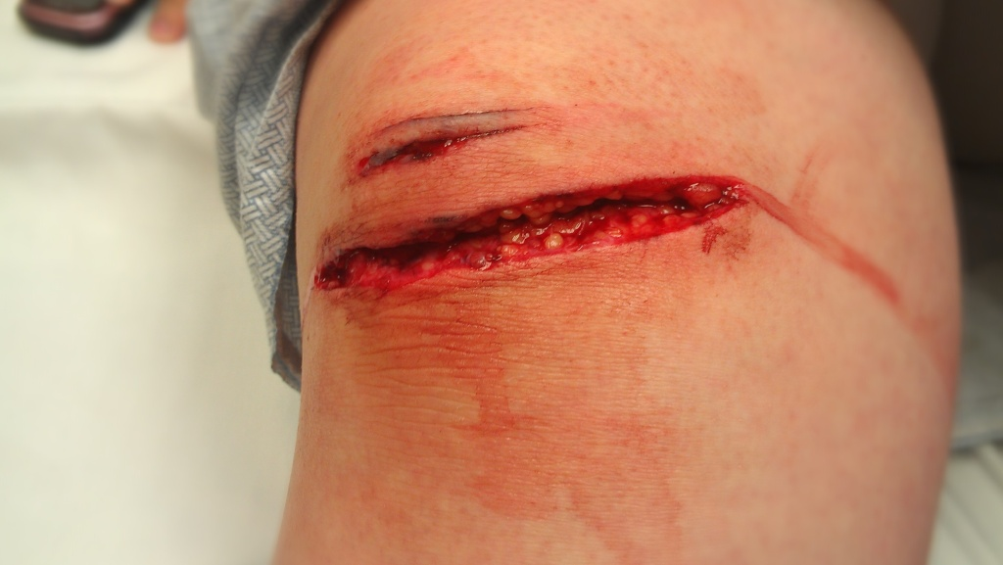
Laceration

Slide 11
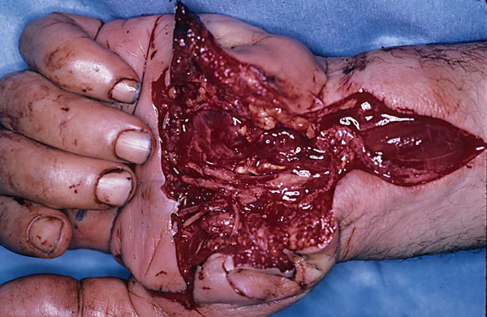
Palm Laceration

Slide 12
Incised like or incised looking wounds
Laceration produced without excessive skin crushing by blunt object on the areas where the skin is close to bone and subcutaneous tissues are scanty, may produce a wound which by linear splitting of tissues, may look like incised wound.
Sites are scalp, eyebrows, shin, etc

Slide 13
STRETCH LACERATION
Overstretching of skin, if it is fixed, will cause laceration.
Seen in running over by vehicles and flap may indicate the direction of motion.

Slide 14
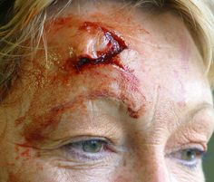
STRETCH LACERATION

Slide 15
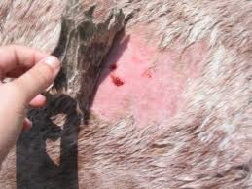
STRETCH LACERATION

Slide 16
AVULSION
It is produced by shearing force delivered at an
acute angle to detach a portion of traumatised
surface or viscus from its attachments .
Flaying
It is separation of skin from underlying tissues by
shearing or grinding force by a weight, such as
lorry wheel passes over a limb.

Slide 17
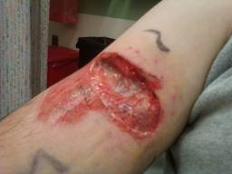
AVULSION

Slide 18
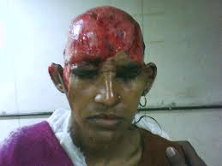
AVULSION SCALP

Slide 19
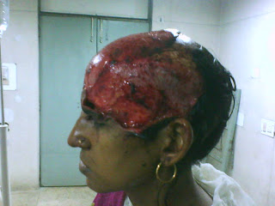
AVULSION SCALP

Slide 20
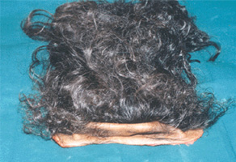
AVULSED SCALP

Slide 21
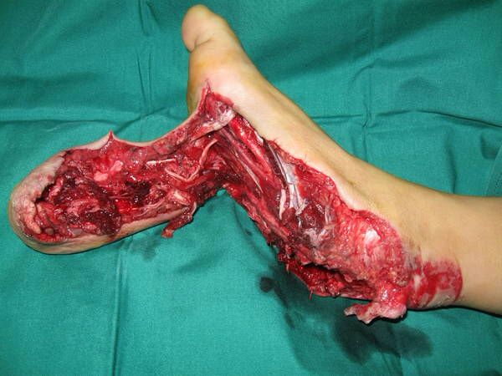
AVULSION FOOT

Slide 22
TEAR
Tearing of skin and tissues can occur from impact by or against the irregular or semi-sharp objects, such as door handle of the car.
A tear is deeper at starting point than at the termination

Slide 23
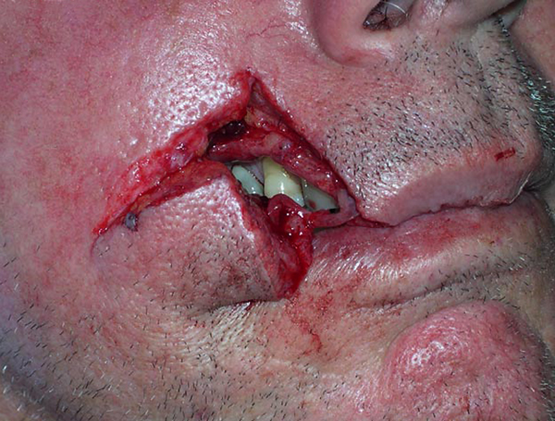
TEAR

Slide 24
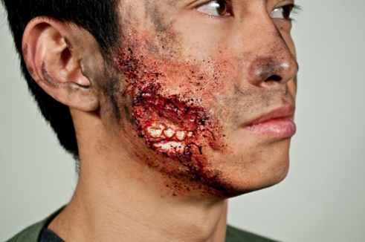
TEAR

Slide 25
CUT LACERATION
Produced by heavy relatively sharp-edged instruments.
The object producing a lacerated wound crushes and stretches a broad area of skin, which then split in the centre.
The edges are irregular and rough.
The skin is abraded at the margins due to rubbing of the striking object.
Margins are contused due to the bleeding in to tissues caused by trauma.

Slide 26
Laceration of the internal organs is produced
by:
1. Direct injury of the viscera by fragments of fractured bone.
2. Development of the traction shears or strain shears in viscera.
3. Stretching of the visceral attachments.
4. Hydrostatic forces

Slide 27
Characters
Margins are irregular, ragged, and uneven and their ends are pointed or blunt, and they too show minute tears in the margins.
Bruising is seen either in the skin or the subcutaneous tissues around the wound.
Deeper tissues are unevenly divided with tags of tissues at the bottom of the wound bridging across the margin.

Slide 28
Hair bulbs &blood vessels are crushed.
Haemorrhage is less.
Foreign materials are found in the wound.
Depth varies according to the thickness of the soft parts at the site of injury and degree of force applied

Slide 29
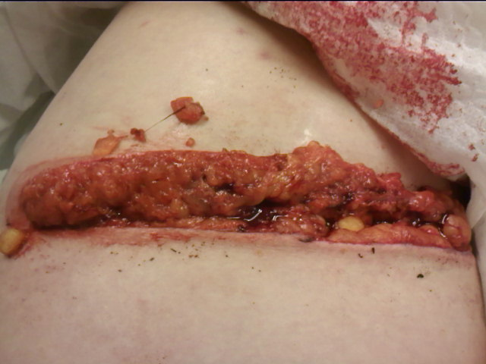

Slide 30
The shape and size may not correspond with the
weapon or object which produced it.
i) A blunt round end may produce stellate
laceration.
A blunt object with an edge such as hammer may produce crescentic laceration.
Long thin object such as pipes may produce
linear laceration.
Flat object may produce irregular, ragged or
Y- shaped laceration.

Slide 31
Age determination of the laceration is difficult unless there is clear signs of healing such as granulation tissue, fibroblast ingrowth or organising infiltrate.
Ante mortem lacerations show bruising, eversion, gaping and blood staining of margins, greater bleeding and vital reaction.

Slide 32
Healing of a lacerated wound
Fresh : Bleeding or fresh clot is attached; margins are red, swollen and tender.
12-24 hrs :Margins swollen, red and covered by dried blood clots, and lymph.
3-5 days: Margins strongly adhered with each other and covered by dried crust.
6-7 days: Crust/scab falls off or can easily be taken off with soft reddish tender scar.
Few weeks: Scar is whitish, firm and painless

Slide 33
Complications
1. Laceration of internal organs can cause fatal bleeding.
2. Temporal arteries may bleed freely as they are firmly bound and unable to contract.
3. Infection
4. If it is located where the skin stretches or is wrinkled, e.g. over joints, repeated and continued oozing of tissue fluids and blood may cause irritation, pain and dysfunction.
5. Pulmonary or systemic fat embolism.

Slide 34
Medico Legal Importance
The type of laceration may indicate the cause of the injury and shape of the blunt weapon
Foreign bodies found in the wound may indicate the circumstances in which the crime has been committed
Age of the injury can be determined

Slide 35
Circumstances of the Injuries
Violent uncoordinated muscular contraction can
produce disruptive tissue stresses which produce
fracture and laceration of tendon and muscles
Internal forces and hydrostatic pressure created by convulsions can produce mural laceration in hollow viscera
Suicidal laceration are usually situated on the exposed parts
Homicidal laceration are usually present on head

Slide 36
Combinations of abrasions, contusions &
lacerations
They are seen together or as integral parts of one another.
The same object may produce the contusion with the one blow, a laceration with the second ,and abrasion with the third.
Sometimes , all three types are produced with the single blow.

Slide 37
Punching
Blow with the clenched fist will produce abrasion and contusion , laceration may occur over bony prominences .
Punches on the face may split the lips, fracture the teeth, nose, jaw, or maxilla and produce black eye.

Slide 38
Kicking
Kicking and stamping injuries are caused by a foot which is either swung or moved downwards with some force.
They produce abrasions, contusion and sometimes lacerations , which are more severe than punching.

Slide 39
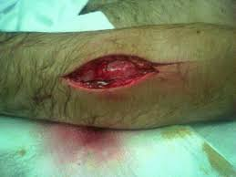

Slide 40
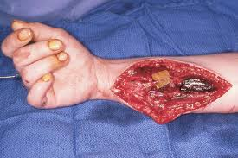

Slide 41
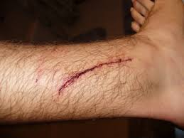

Slide 42
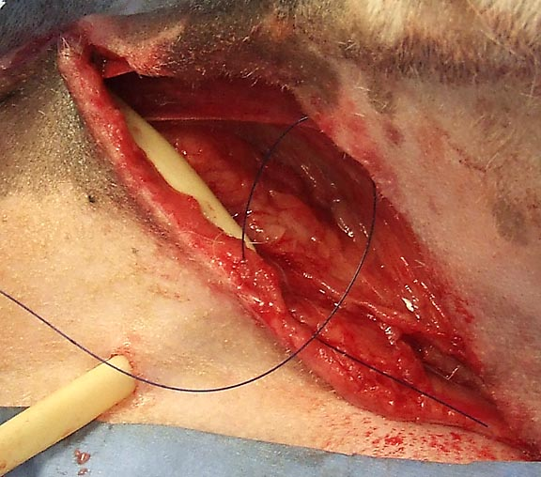

Slide 43
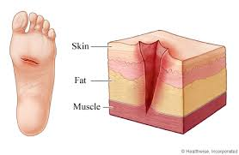

Slide 44
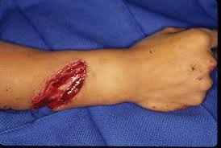

Slide 45
QUESTIONS
Question 1.
Laceration wound may resemble incised looking wound, if it is present at:
Abdomen
Chest
Forehead.
Thighs

Slide 46
Question 2.
One of the following laceration may be mistaken as incised wound:
Avulsion
Split laceration
Tear laceration
Stretch laceration

Slide 47
Question 3.
A heavy edged weapon like chopper can produce:
Tears
Split laceration
Cut laceration.
Stretch laceration

Slide 48
Question 4.
Open wound is :
Black eye
Fracture
Laceration.
Contusion

Slide 49
Question 5.
Incised looking lacerated wound are seen at:
Chest
Abdomen
Forehead.
Hands

Slide 50
Question 6.
Maximum bleeding is seen in:
Lacerated wound
Incised wound.
Abrasion
Contusion

Slide 51
Question 7.
Swallow tails are seen in:
Abrasions
Contusion
Laceration.
Incised wound

Slide 52
Question 8.
Incised looking wound is in fact:
An incised wound
A lacerated wound
A fire arm injury
A stab wound

Slide 53
Question 9.
Split laceration is due to:
Blunt object.
Sharp object
Sharp heavy object
Pointed object

Slide 54
Question 10.
Tissue bridges are seen in :
Abrasion
Contusion
Laceration.
Stab wound

Slide 55


